Slide 1



2160710
Distributed Operating System
Unit-3
Synchronization in Distributed Systems
Prof. Rekha K. Karangiya
9727747317
Rekha.karangiya@darshan.ac.in

Slide 2
Topics to be covered
Clock Synchronization
Clock Synchronization Algorithms
Centralized Algorithms
Distributed Algorithms
Mutual Exclusion
Deadlock
Election Algorithms

Slide 3
Synchronization
Synchronization is coordination with respect to time, and refers to the ordering of events and execution of instructions in time.
“Ordering of all actions”
Because various components of a distributed system must cooperate and exchange information, synchronization is a necessity.
Examples:
Producer-Consumer relationship.
Tape drive cannot be used simultaneously by multiple processes.
ATM machine.

Slide 4
Synchronization
Difficult to implement synchronization in distributed environment
Memory is not shared.
Clock is not shared.
Decisions are usually based on local information.
Centralized solutions undesirable (single point of failure, performance bottleneck).

Slide 5
Clock Synchronization
It is often important to know when events occurred and in what order they occurred.
Need to know when a transaction occurs.
Online reservation system.
E-mail sorting can be difficult if time stamps are incorrect.
In a non-distributed system dealing with time is trivial as there is a single shared clock, where all processes see the same time.
In a distributed system, on the other hand, each computer has its own clock.
Because no clock is perfect each of these clocks has its own skew which causes clocks on different computers to drift and eventually become out of sync.

Slide 6
Clock Synchronization
Computer clock usually consists of three elements
Quartz crystal : oscillates at a well defined frequency.
Constant register : store a constant value, that is decided based on frequency.
Counter register : used to keep track of the oscillations of quartz crystal.

Slide 7
Drifting of Clock
Differences in crystals result in difference in the rate at which two clocks run.
Difference is small but observable, no matter how accurately initialized.
Hence, Computer clock must be periodically synchronized with the real-time clock called non-faulty.
Even non-faulty clocks do not always maintain perfect time.
A clock is called non-faulty if there is bound on the amount of drift.
Clock drift: The computer clock differs from the real time clock.
Clock Skew: Difference between two clocks at one point in time.

Slide 8
Drifting of Clock
Synchronization techniques
External Synchronization
Synchronization with real time (external) clocks.
Mutual (Internal) Synchronization
For consistent view of time across all nodes of the system.

Slide 9

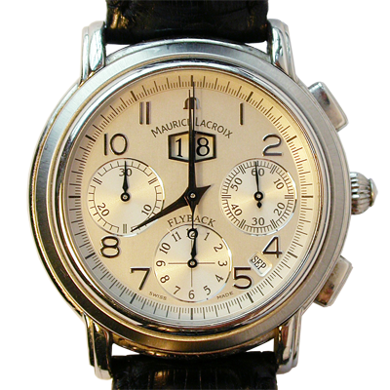
Drifting of Clock
Sept 18, 2016
8:00:00

Slide 10


Drifting of Clock
8:01:24
8:01:48
Skew = +84 seconds
+84 seconds/35 days
Drift = +2.4 sec/day
Oct 23, 2016
8:00:00
Skew = +108 seconds
+108 seconds/35 days
Drift = +3.1 sec/day

Slide 11



Drifting – Perfect Clock
$$\frac{dC}{dt}>1$$
$$\frac{dC}{dt}=1$$
$$\frac{dC}{dt}<1$$
skew
skew
C denotes the time value of a clock
Fast clock
Perfect clock
Computer’s time, C
Slow clock
UTC time, t
UTC= Coordinated Universal Time

Slide 12
Dealing with Drift
Assume we set computer to true time. (It is not good idea to set clock back.)
Illusion of time moving backwards can confuse message ordering and software development environments.
There should be go for gradual clock correction.
If fast: Make clock run slower until it synchronizes.
If slow: Make clock run faster until it synchronizes.
Operating System can change rate at which it requests interrupts.
if system requests interrupts every 14 msec but clock is too slow: request interrupts at 12 msec.
Software correction: Redefine the interval.

Slide 13
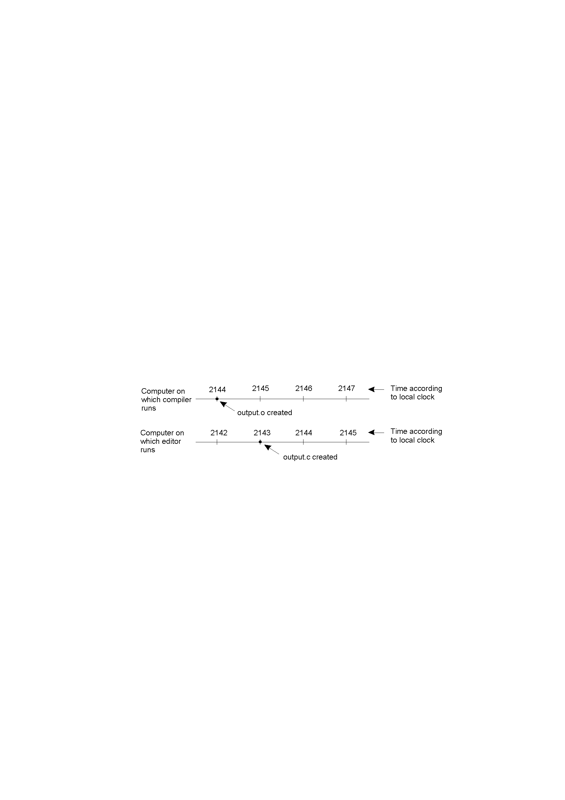
Dealing with Drift
In a distributed system, achieving agreement on time is not easy.
Assume no global agreement on time. Let’s see what happens:
Assume that the compiler and editor are on different machines
output.o has time 2144 msec
output.c is modified but is assigned time 2143 msec because the clock on its machine is slightly behind.
Make will not call the compiler.
The resulting executable will have a mixture of object files from old and new sources.

Slide 14
Clock Synchronization Algorithms
Clock Synchronization
Centralized Algorithms
Distributed Algorithms
Passive Time Server Centralized Algorithm
Active Time Server Centralized Algorithm
Global Averaging Distributed Algorithm
Localized Averaging Distributed Algorithm

Slide 15
Centralized Algorithms
One node has a real-time receiver called time server node.
Clock time of this node used to correct the time of all other nodes.
The goal of this algorithm is to keep the clock of all other nodes synchronized with the clock time of the time server node.
Drawbacks
Single point of failure.
Poor scalability.
Depending the role of the server node, centralized algorithms are again of two types,
Passive time server
Active time server

Slide 16
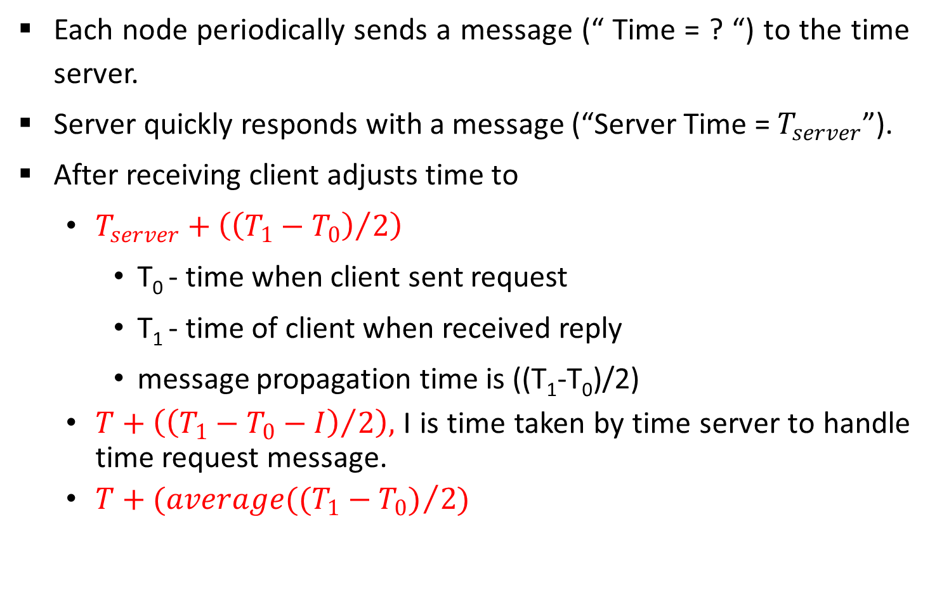
Passive Time Server Algorithm
Each node periodically sends a message (“ Time = ? “) to the time server.
Server quickly responds with a message (“Server Time = $T_{server}$”).
After receiving client adjusts time to
$T_{server}+\left({\left(T_{1}−T_{0}\right)}/2\right)$
T₀ - time when client sent request
T₁ - time of client when received reply
message propagation time is ((T₁-T₀)/2)
$T+\left({\left(T_{1}−T_{0}−I\right)}/2\right),$ I is time taken by time server to handle time request message.
$T+(average({(T_{1}−T_{0})}/2)$

Slide 17
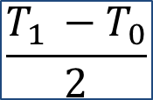
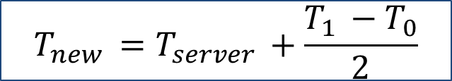
Cristian’s Algorithm
Note times:
Request sent: T₀
Reply received: T₁
Assume network delays are symmetric.
Client sets time to:
T_{server}
server
request
reply
client
T₀
T₁
time
$$\frac{T_{1 }−T_{0}}{2}$$
= estimated overhead in each direction
$$T_{new }=T_{server }+\frac{T_{1 }−T_{0}}{2}$$

Slide 18
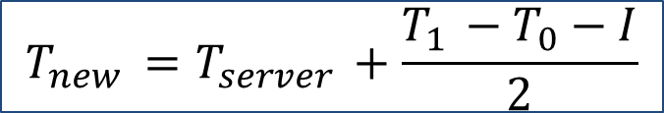
Cristian’s Algorithm
Note times:
Request sent: T₀
Reply received: T₁
Assume network delays are symmetric.
Client sets time to:
T_{server}
server
request
reply
client
T₀
T₁
time
I = server processing time
$$T_{new }=T_{server }+\frac{T_{1 }−T_{0}−I}{2}$$

Slide 19
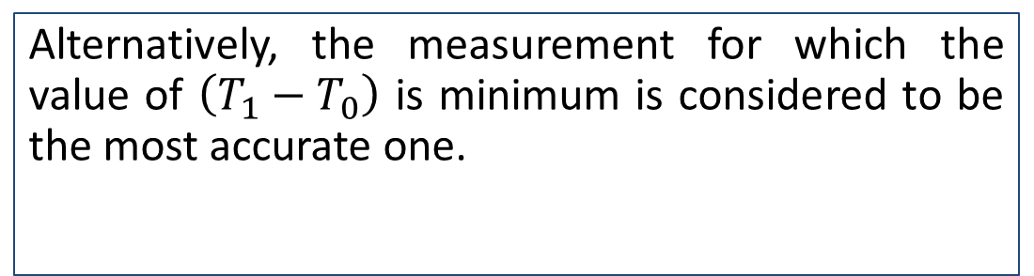

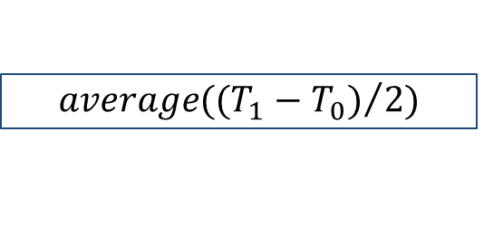
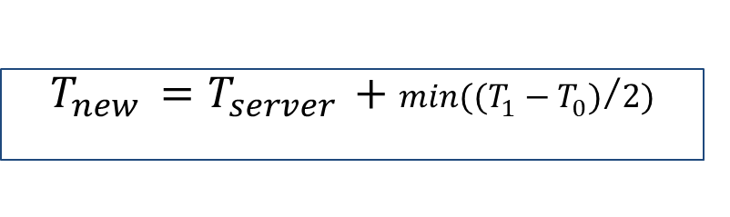
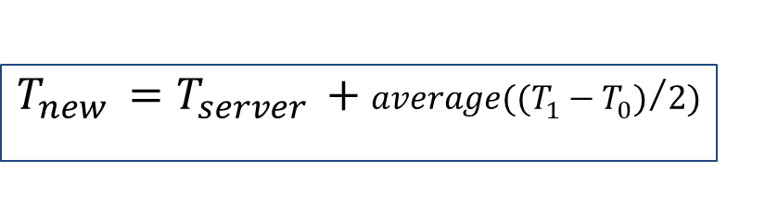
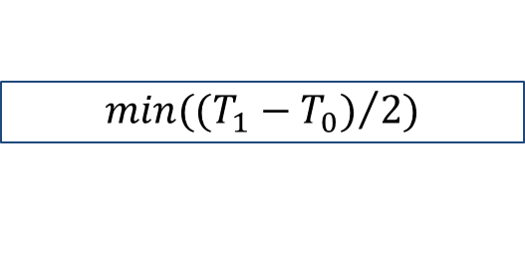
Cristian’s Algorithm
T_{server}
server
request
reply
client
T₀
T₁
time
Several measurements of $\left(T_{1}−T_{0}\right)$ are made, those measurements for which $\left(T_{1}−T_{0}\right)$ exceeds some threshold value are considered to be unreliable and discarded.
Average of the remaining measurements is then calculated.
Alternatively, the measurement for which the value of $\left(T_{1}−T_{0}\right)$ is minimum is considered to be the most accurate one.
$$min({(T_{1}−T_{0})}/2)$$
$$T_{new }=T_{server }+min({(T_{1}−T_{0})}/2)$$
$$average({(T_{1}−T_{0})}/2)$$
$$T_{new }=T_{server }+average({(T_{1}−T_{0})}/2)$$

Slide 20

Error Bounds in Cristian’s Algorithm
T_{server}
server
request
reply
client
T₀
T₁
time
T_{min}
T_{min}
Earliest time message arrives
Latest time message leaves
range = T₁-T₀-2T_{min}
Accuracy of Result =
$±\frac{T_{1 }−T_{0}}{2} −$ $T_{min }$

Slide 21
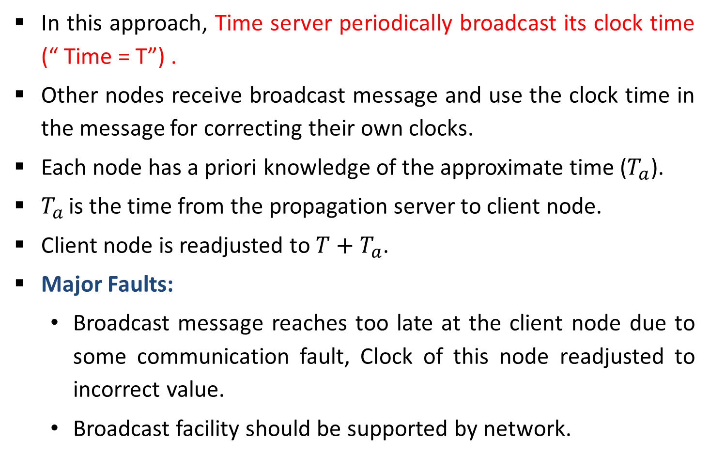
Active Time Server Algorithm
In this approach, Time server periodically broadcast its clock time (“ Time = T”) .
Other nodes receive broadcast message and use the clock time in the message for correcting their own clocks.
Each node has a priori knowledge of the approximate time ($T_{a}$).
$T_{a}$ is the time from the propagation server to client node.
Client node is readjusted to ${T+T}_{a}$.
Major Faults:
Broadcast message reaches too late at the client node due to some communication fault, Clock of this node readjusted to incorrect value.
Broadcast facility should be supported by network.

Slide 22
Active Time Server Algorithm- Solution
Berkeley Algorithm:
Used for internal clock synchronization of a group.
Time server periodically sends a message (“time=?”) to all computers in the group.
Each computer in the group sends its clock value to the server.
Server has prior knowledge of propagation time from node to server.
Time server readjusts the clock values of the reply messages using propagation time & then takes fault tolerant average.
The time server readjusts its own time & sends the adjustment (positive or negative) to each node.

Slide 23

Berkeley Algorithm: Example
3:00
0.05
-0:20
3:25
2:50
9:10
+0:15
-6:05
×
3:25
2:50
9:10
Request timestamps from all slaves
Compute fault-tolerant average:
(3:25 + 2:50 + 3:00)/3 = 3:05
Send offset to each client

Slide 24
Distributed Algorithms
All nodes are equipped with real time receiver so that each node’s clock is independently synchronized with real time.
External synchronization also results in internal synchronization.
Internal synchronization performed for better results.
Types of internal Synchronization:
Global averaging distributed algorithms
Localized averaging distributed algorithms

Slide 25
Global Averaging Algorithm
Each node broadcasts its local clock time in the form of a special “resync” message.
All broadcasts do not happen simultaneously due to difference in local clocks.
After broadcasting the clock value , the clock process of a node waits for time T ( T is calculated by algorithm).
During this period, clock process collects the resync messages broadcast by other nodes.
Clock process estimates the skew of its clock with respect to other nodes (when message received) .
It then computes a fault-tolerant average of the estimated skews and use it to correct the local clock.

Slide 26
Local Averaging Algorithm
This algorithm attempt to overcome the drawbacks of the global averaging algorithm.
Nodes of a distributed system are logically arranged in some kind of pattern such as Ring.
Periodically each node exchange its clock time with its neighbors in the ring.
And then sets its clock time by taking Average.
Average is calculated by , its own clock time and clock times of its neighbors.

Slide 27
Event Ordering
Observations by Lamport
If two processes do not interact, it is not necessary to keep their clocks synchronized.
All processes need not agree on exactly what time it is, rather they agree on the order in which events occur.
Events can be
Procedure invocation
Instruction execution
Message exchange (Send/ Receive)
Defined relation happened before, for partial ordering of events.

Slide 28
Happened Before Relation
Happened before relation ( casual ordering)
If a and b are events in the same process, and a occurs before b then a→ b is true.
If a is the event of a message being sent by one process, and b is the event of the message being received by another process, then a → b is also true.
If a → b and b → c, then a → c (transitive).
Irreflexive, a → a not true.
Concurrent Events - events a and b are concurrent (a||b) if neither a → b nor b → a is true.

Slide 29
Logical Clocks
Need globally synchronized clocks to determine a → b
Rather use Logical clock concept
Associate timestamp with every event.
Timestamps assigned to events by logical clocks must follow clock condition : if a → b, then C(a) < C(b).
Conditions to follow to satisfy clock condition
If a occurs before b in process P_{i} then C_{i}(a) < C_{i}(b).
If a is the sending of a message by process P_{i} and b is the receipt of that message by process P_{j} then C_{i}(a) <C_{j}(b).
Clocks should always go forward, that is corrections should be positive value.
To meet the above conditions : Lamport’s algorithm

Slide 30
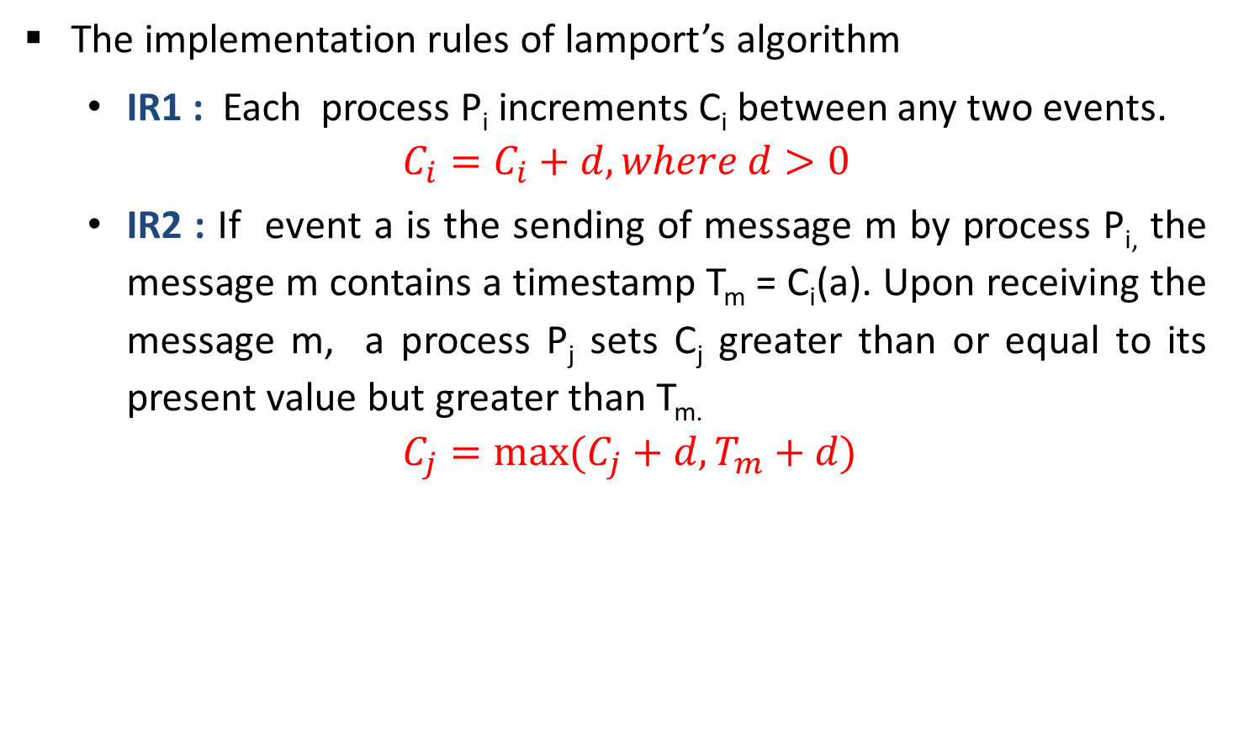
Lamport’s Algorithm
The implementation rules of lamport’s algorithm
IR1 : Each process P_{i} increments C_{i} between any two events.
$$C_{i}=C_{i}+d, where d>0$$
IR2 : If event a is the sending of message m by process P_{i,} the message m contains a timestamp T_{m} = C_{i}(a). Upon receiving the message m, a process P_{j} sets C_{j} greater than or equal to its present value but greater than T_{m.}
$$C_{j}=max⁡(C_{j}+d,T_{m}+d)$$

Slide 31
Implementation of Logical Clock using Counters
All processors have counters acting as logical clocks.
Counters initialized to zero & incremented by 1 whenever an event occurs in that process.
On sending of a message, the process includes the incremented value of the counter in the message.
On receiving the message, counter value incremented by 1 & then checked against counter value received with message.
If counter value is less than that of received message, the counter value set to (timestamp in the received message + 1). Ex. e₁₃
If not , the counter value is left as it is. Ex. e₀₈

Slide 32


























Implementation of Logical Clock
$$c_{1}=8$$
$$e_{08}$$
Timestamp = 6
$$c_{1}=7$$
$$e_{07}$$
$$c_{2}=6$$
$$e_{14}$$
$$c_{1}=6$$
$$e_{06}$$
$$e_{13}$$
$$c_{2}=3$$
5
$$c_{1}=5$$
$$e_{05}$$
Timestamp = 4
Since 3 is less than timestamp 4
$$c_{1}=4$$
$$e_{04}$$
$$c_{1}=3$$
$$e_{03}$$
$$e_{12}$$
$$c_{2}=2$$
$$c_{1}=2$$
$$e_{02}$$
$$c_{1}=1$$
$$e_{01}$$
$$e_{11}$$
$$c_{2}=1$$
$$c_{1}=0$$
$$c_{2}=0$$
Process P₁
Process P₂

Slide 33
Mutual Exclusion
Exclusive access to shared resources achieved by critical sections & mutual exclusion.
Conditions to be satisfied by mutual exclusion:
Mutual exclusion - Given a shared resource accessed by multiple concurrent processes, at any time only one process should access the resource. A process that has been granted the resource must release it before it can be granted to another process.
No starvation – If every process that is granted resource eventually releases it, every request will be eventually granted.

Slide 34
Centralized Mutual Exclusion Algorithm
Coordinator coordinates entry to critical section.
Allows only one process to enter critical section.
Ensures no starvation as uses first come, first served policy.
Simple implementation
3 messages per critical section – request, reply, release.
Single point of failure & performance bottleneck.

Slide 35








Centralized Mutual Exclusion Algorithm
Process P₂ then asks permission to enter the same critical region. The coordinator does not reply.
$$P_{2}$$
On receiving release message, P_{c} takes the first request from the queue and sends a reply message.
P_{c} sends back a reply message granting permission to P₁ as critical section is free.
6 Reply
3 Request
7 Release
5 Release
9 Release
$$P_{1}$$
2 Reply
$$P_{C}$$
8 Reply
$$P_{3}$$
1 Request
4 Request
When process P₁ exits the critical section sends a release message to P_{c}
Process P₁ wants to enter a critical section for which it sends a request to P_{c}
Initial state
$$P_{2}$$
Status after 3
$$P_{3}$$
$$P_{2}$$
Status after 4
$$P_{3}$$
Status after 5
Status after 7

Slide 36
Distributed Mutual Exclusion Algorithm
Ricart & Agrawala’s Algorithm
When a process wants to enter the CS, it sends a request message to all other processes, and when it receives reply from all processes, then only it is allowed to enter the CS.
The request message contains following information:
Process identifier
Name of CS
Unique time stamp generated by process for request message.

Slide 37
Distributed Mutual Exclusion Algorithm
The decision whether receiving process replies immediately to a request message or defers its reply is based on three cases:
If receiver process is in its critical section, then it defers its reply.
If receiver process does not want to enter its critical section, then it immediately sends a reply.
If receiver process itself is waiting to enter critical section, then it compares its own request timestamp with the timestamp in request message
If its own request timestamp is greater than timestamp in request message, then it sends a reply immediately.
Otherwise, the reply is deferred.

Slide 38




Distributed Mutual Exclusion Algorithm
TS=6
OK
P₁
P₂
P₁
P₂
$$P_{1}$$
TS=4
Defers sending a reply to P₁
TS=6
TS=4
OK
OK
TS=4
TS=6
P₄
P₃
$$P_{2}$$
$$P_{1}$$
P₄
P₃
Already in CS
Defers sending a reply to P₁ and P₂
(a)
(b)
P₁
P₁
OK
Exits CS
P₂
$$P_{1}$$
P₂
Enters CS
Enters CS
OK
OK
P₄
P₃
P₄
P₃
Exits CS
(c)
(d)

Slide 39
Token Ring Algorithm
3
6
7
0
1
4
5
2
Token
Token
0
2
4
9
7
1
6
5
8
3
An unordered group of processes on a network.
A logical ring constructed in software.
When the ring is initialized, process 0 is given a token.
The token circulates around the ring.
When a process acquires the token from its neighbor, it checks to see if it is attempting to enter a critical region.
If so, the process enters the region, does all the work it needs to, and leaves the region.
It then passes the token to its neighbour process.

Slide 40
Token Ring Algorithm
3
6
7
0
1
4
5
2
0
2
4
9
7
1
6
5
8
3
An unordered group of processes on a network.
A logical ring constructed in software.
After it has exited, it passes the token along the ring. It is not permitted to enter a second critical region using the same token.
If a process is handed the token by its neighbor and is not interested in entering a critical region, it just passes it along.
As a consequence, when no processes want to enter any critical regions, the token just circulates at high speed around the ring.
It is passed from process k to process k +1 (modulo the ring size) in point-to-point messages.

Slide 41
Token Ring Algorithm
Two types of failure can occur:
Process failure: A process failure in the system causes the logical ring to break.
Requires detection of failed process & dynamic reconfiguration of logical ring.
Process receiving token sends back acknowledgement to neighbor.
When a process detects failure of neighbor, it removes failed process by skipping it & passing token to process after it.
When a process becomes alive after recovery, It informs the neighbour previous to it so that it gets the token during the next round of circulation.

Slide 42
Token Ring Algorithm
Lost token: if the token is lost, a new token must be generated.
Must have mechanism to detect & regenerate token.
Designate process as monitor. Monitor periodically circulates “who has token”.
Owner of token writes its process identifier in message & passes on.
On receipt of message, monitor checks process identifier field. If empty generate new token & passes it.
Multiple monitors can be used.

Slide 43
Deadlock
A set of processes is in a deadlock state if every process in the set is waiting for an event (release) that can only be caused by some other process in the same set.
Example:
System has 2 tape drives
P1 and P2 each hold one tape drive and each needs another one.
P₁
Process
Process
R₁
Deadlock
R₂
Request
Hold
P₂
Resource
Resource

Slide 44
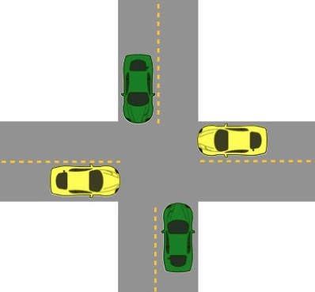
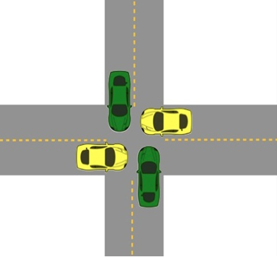
Deadlock
The processes are the cars.
The resources are the spaces occupied by the cars
Deadlock possible
Deadlock occurred

Slide 45
Necessary Conditions for Deadlock
Mutual exclusion:
Each resource is either currently assigned to exactly one process or is available.
No resource can be shared by more than one process at a time (e.g., Memory location).
Hold and Wait:
The process currently holding resources granted earlier can request more resources.
No pre-emption:
Previously granted resources cannot be forcibly taken away from process.

Slide 46
Necessary Conditions for Deadlock
Circular wait:
Two or more processes must form a circular chain in which each process is waiting for a resource that is held by the next member of the chain.
All four of these conditions must be present for a deadlock to occur.

Slide 47
Handling Deadlocks In DOS
Handling of deadlocks in distributed systems is more complex than in centralized systems.
Because the resources, the processes, and other relevant information are scattered on different nodes of the system.
Strategies to handle deadlocks:
Ignore:
Do nothing, just ignore the problem.
Detect:
Allow the deadlock to occur, detect it, and then deal with it by aborting and restarting a transaction that causes deadlock.

Slide 48
Handling Deadlocks In DOS
Prevent
Make deadlock impossible by granting requests such that one of the conditions necessary for deadlock does not hold.
Avoid
Choose resource allocation so deadlock does not occur (but algorithm needs to know what resources will be used and when)

Slide 49
Deadlock Prevention
Deadlock can be prevented by attacking the one of the four conditions that leads to deadlock.
Attacking the Mutual Exclusion Condition
Attacking the Hold and Wait Condition
Attacking the No Preemption Condition
Attacking the Circular Wait Condition

Slide 50
Attacking the Mutual Exclusion Condition
No deadlock if each resource can be assigned to more than one process.
Not practical if an object gets modified.
This can violate the ACID properties of a transaction
We can not assign some resources to more than one process at a time such as printer.
Not feasible

Slide 51
Attacking the Hold and Wait Condition
Require processes to request all their resources before starting execution.
Instead of requesting all its resources before its execution starts, a process may request resources during its execution.
A process is allowed to run if all resources it needed is available. Otherwise nothing will be allocated and it will just wait.
Problem with this strategy is that a process may not know required resources at start of run.
Resource will not be used optimally.
It may cause starvation of a process that needs may resources.

Slide 52
Attacking the Circular Wait Condition
To provide a global numbering of all the resources.
Processes can request resources whenever they want to, but all requests must be made in numerical order.
A process need not acquire them all at once.
Circular wait is prevented if a process holding resource n cannot wait for resource m, if m > n.
Printer
Scanner
Plotter
Tape drive
CD ROM
A process may request 1st a CD ROM drive, then tape drive. But it may not request 1st a plotter, then a Tape drive.
Resource graph can never have cycle.

Slide 53
Attacking the No Preemption Condition
When a process request for a resource that is currently not available, all the resources held by the process are taken away from it and process is blocked.
When a process request for a resource that is currently not available, the system checks if the requested resource is held by a process that is blocked.
If so, the requested resource is taken away from the waiting process and given it to the requesting process.

Slide 54
Attacking the No Preemption Condition
When two or more transactions compete for the same resource, their priority numbers are used to break the tie.
Assign a unique timestamp to each transaction.
Ensure that the Global Wait-For Graph can only proceed from young to old or from old to young.

Slide 55
Attacking the No Preemption Condition
When a process is about to block waiting for a resource used by another
Check to see which has a larger timestamp.
Allow to wait only if the waiting process has an older timestamp (is older) then the process waited for.
Alternatively: allow processes to wait only if the waiting process has a higher (younger) timestamp than the process waiting for.

Slide 56
Wait-die Algorithm
Old process wants resource held by a younger process
old process waits.
Young process wants resource held by older process
young process kills itself.
Wants resource
Holds resource
Old process
TS=123
Young process
TS=311
old process TS=123
Waits
Wants resource
Holds resource
Only permit older processes to wait on resources held by younger processes.
Young process
TS=311
Old process
TS=123
Dies

Slide 57
Wound-wait Algorithm
Instead of killing the transaction making the request, kill the resource owner.
Old process wants resource held by a younger process
old process kills the younger process.
Young process wants resource held by older process
young process waits.
Wants resource
Holds resource
Old process
TS=123
Young process
TS=311
old process TS=123
Kills young process
Wants resource
Holds resource
Young process
TS=311
Old process
TS=123
Only permit younger processes to wait
on resources held by older processes.
Waits

Slide 58
Deadlock Detection
Kill off one or more processes when deadlock is detected.
That breaks the circular dependency.
It might not feel good to kill a process.
But transactions are designed to be abortable.
So just abort one or more transactions.
System restored to state before transaction began.
Transaction can restart at a later time.

Slide 59
Centralized Deadlock Detection
Handle the non-distributed algorithm through a coordinator.
Each system maintains a Wait-For Graph for its processes and resources.
A central coordinator maintains the combined graph for the entire system: the Global Wait-For Graph.
A message is sent to the coordinator each time an edge (resource hold/request) is added or deleted.
List of adds/deletes can be sent periodically.

Slide 60
Centralized Deadlock Detection
P0
S
S
P2
R
T
P1
P0
S
P2
Local wait-for graph on A
Local wait-for graph on B
R
T
P1
Global wait-for graph

Slide 61
Centralized Deadlock Detection
Two events occur:
Process P₁ releases resource R on system A
Process P₁ asks system B for resource T
Two messages are sent to the coordinator:
1 (from A): release R
2 (from B): wait for T
If message 2 arrives first, the coordinator constructs a graph that has a cycle and hence detects a deadlock. This is false deadlock.

Slide 62
False Deadlock Example
P0
S
P2
P0
S
P2
P0
S
P2
R
T
R
T
R
T
×
P1
P1
P1
No deadlock
P1: release(R)
P1: wait-for(T)
All good: no deadlock detected!

Slide 63
False Deadlock Example
P0
S
P2
P0
S
P2
P0
S
P2
R
T
R
T
R
T
×
Message 1
Message 2
P1
P1
P1
False deadlock
No deadlock
P1: wait-for(T)
P1: release(R)
DEADLOCK detected!
Do Something!
It really wasn’t deadlock since P1 released R
Too late!
We detected deadlock because the coordinator received the messages out of order

Slide 64
Avoiding False Deadlock
Impose globally consistent (total) ordering on all processes. or
Have coordinator reliably ask each process whether it has any release messages.

Slide 65
Distributed Deadlock Detection
Processes can request multiple resources at once.
Consequence: process may wait on multiple resources.
Some processes wait for local resources.
Some processes wait for resources on other machines.
Algorithm invoked when a process has to wait for a resource.

Slide 66
Distributed Deadlock Detection
Chandy-Misra-Haas algorithm
When requesting a resource, generate a probe message.
Send to all process(es) currently holding the needed resources
Message contains three process IDs: {blocked ID, my ID, holder ID}
Process that originated the message.
Process sending (or forwarding) the message.
Process to whom the message is being sent.

Slide 67
Distributed Detection Algorithm
When probe message arrives, recipient checks to see if it is waiting for any processes.
If so, update & forward message: {blocked ID, my ID, holder ID}
Replace second field by its own process ID.
Replace third field by the ID of the process it is waiting for.
Send messages to each process on which it is blocked.
If a message goes all the way around and comes back to the original sender, a cycle exists.
We have deadlock.

Slide 68
Distributed Detection Algorithm
(0,8,0)
(blocked ID, my ID, holder ID)
P4
(0,4,6)
P6
(0,6,8)
P8
(0,3,4)
P0
(0,0,1)
P1
(0,1,2)
P2
(0,2,3)
P3
P5
P7
System A
System B
System C
Process 0 is blocking on process 1
Initial message from P0 to P1: (0,0,1)
P1 sends (0, 1, 2) to P2 ;
P2 sends (0, 2, 3) to P3 ;
Message (0,8,0) returns back to sender.
cycle exists: deadlock

Slide 69
Deadlock Recovery
Recovery through preemption
In some cases, it may be possible to temporarily take a resource away from its current owner and give it to another process.
Recovering this way is frequently difficult or impossible.
Choosing the process to suspend depends largely on which ones have resources that can easily be taken back.
P₁
R₁
R₂
P₂

Slide 70
Deadlock Recovery
Recovery through killing processes
The simplest way to break a deadlock is to kill one or more processes.
Kill all the process involved in deadlock.
Kill process one by one.
After killing each process check for deadlock.
If deadlock recovered then stop killing more process.
Otherwise kill another process.

Slide 71
Deadlock Recovery
Recovery through rollback
Checkpoint a process periodically.
Check pointing a process means that its state is written to a file so that it can be restarted later.
When deadlock is detected, rollback the preempted process up to the previous safe state before it acquired that resource.

Slide 72
Election Algorithm
Several distributed algorithms require a coordinator process in the entire System.
It performs coordination activity needed for the smooth running of processes.
Two examples of such coordinator processes encountered here are:
The coordinator in the centralized algorithm for mutual exclusion.
The central coordinator in the centralized deadlock detection algorithm.
If the coordinator process fails, a new coordinator process must be elected to take up the job of the failed coordinator.

Slide 73
Assumptions: Election Algorithm
Election algorithms are meant for electing a coordinator process from the currently running processes.
Election algorithms are based on the following assumptions:
Each process in the system has a unique priority number.
Whenever an election is held, the process having the highest/lowest priority number among the currently active processes is elected as the coordinator.
On recovery, a failed process can take appropriate actions to rejoin the set of active processes.
Election Algorithms are:
Bully Election Algorithm
Ring Election Algorithm

Slide 74
Bully Algorithm
Bully algorithm specifies the process with the highest identifier will be the coordinator of the group. It works as follows:
When a process p detects that the coordinator is not responding to requests, it initiates an election:
p sends an election message to all processes with higher numbers.
If nobody responds, then p wins and takes over.
If one of the processes answers, then p’s job is done.
If a process receives an election message from a lower-numbered process at any time, it:
sends an OK message back.
holds an election (unless its already holding one).

Slide 75
Bully Algorithm
A process announces its victory by sending all processes a message telling them that it is the new coordinator.
If a process that has been down recovers, it holds an election.

Slide 76
Example of Bully Algorithm
1
3
2
4
5
1
3
2
4
5
1
3
2
4
5
Coordinated
Election in progress
Coordinator
Offline
Initially five nodes are in the cluster and node 5 is a globally accepted coordinator.
Let us assume that node 5 goes down and nodes 3 and 2 detect this simultaneously.
Both nodes start election procedure and send election messages to the nodes with greater IDs.
Node 4 kicks out nodes 2 and 3 from the competition by sending OK. Node 3 kicks out node 2.

Slide 77
Example of Bully Algorithm
1
3
2
4
5
1
3
2
4
5
1
3
2
4
5
1
3
2
4
5
Coordinated
Election in progress
Coordinator
Offline
Imagine that node 1 detects failure of 5 now and an election message to the all nodes with greater IDs.
Nodes 2, 3, and 4 kick out node 1.
Node 4 sends an election message to node 5.
Node 5 does not respond, so node 4 declares itself as a coordinator and announce this fact to all other peers.

Slide 78
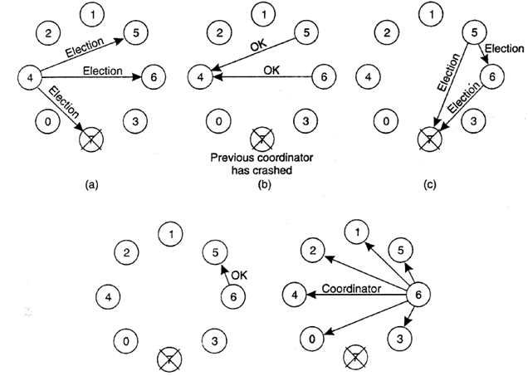
Example of Bully Algorithm

Slide 79
Ring Election Algorithm
The ring algorithm assumes that the processes are arranged in a logical ring and each process is knowing the order of the ring of processes.
If any process detects failure, it constructs an election message with its process ID and sends it to its neighbor.
If the neighbor is down, the process skips over it and sends the message to the next process in the ring.
This process is repeated until a running process is located.

Slide 80
Ring Election Algorithm
At each step, the process adds its own process ID to the list in the message and sends the message to its living neighbor.
Eventually, the election message comes back to the process that started it.
The process then picks either the highest or lowest process ID in the list and sends out a message to the group informing them of the new coordinator.

Slide 81
Example of Ring Election Algorithm
P0
P1
P2
P3
P4
P5
P0
P1
P2
P3
P4
P5
Dead
Dead
1
2
Election:{P2}
Election:{P2,P3}
Fig.1 shows a ring of six processes. P2 detects that the coordinator P0 is dead.
It starts an election by sending an election message containing its process ID to its neighbor P3. (Fig.1)
P3 receives an election message and sends an election message to its neighbor with the ID of P3 suffixed to the list. (Fig.2)

Slide 82
Example of Ring Election Algorithm
P0 is dead
P0
P1
P2
P3
P4
P5
P0
P1
P2
P3
P4
P5
Skip P0
Dead
Dead
3
4
Election:{P2,P3,P4,P5}
Election:{P2,P3,P4,P5}
The same sequence of events occurs with P4, which adds its ID to the list it received from P3 and sends an election message to P5.
P5 then tries to send an election message to P0. (Fig. 3)
P0 is dead and the message is not delivered, P5 tries again to its neighbor P1. (Fig. 4)

Slide 83
Example of Ring Election Algorithm
P0
P1
P2
P3
P4
P5
P0
P1
P2
P3
P4
P5
Dead
Dead
5
6
P1
P1
P1
P1
Election:{P2,P3,P4,P5,P1}
This is me!
Winner!
The message is received by P2, the originator of the election. (Fig. 5)
P2 recognizes that it is the initiator of the election because its ID is the first in the list of processes.
It then picks a leader. it chooses the lowest-numbered process ID, which is that of P1.
It then informs the rest of the group of the new coordinator (Fig. 6).

Slide 84
End of Unit-3
Unit 3: Synchronization in DOS 84 Darshan Institute of Engineering & Technology

